Slide 1

Building XrmToolBox Tools
Jim Novak – FutureZ Consulting

Slide 2





Speaker Profile – Jim Novak
Microsoft MVP, Business Applications
Technical Architect at FutureZ Consulting
@crmdevjim mvp.microsoft.com/en-us/PublicProfile/5003339
futurezconsulting.com/blog
www.linkedin.com/in/jamesnovak
jim@thefuturez.com

Slide 3

XrmToolBox
What is this magical toolbox I hear so much about?

Slide 4
What is XrmToolBox?
“XrmToolBox is a Windows application that connects to Microsoft Dynamics CRM, providing tools to ease customization, configuration and operation tasks. It is shipped with more than 30 plugins to make administration, customization or configuration tasks easier and less time consuming.” – https://www.xrmtoolbox.com/
“If you are not working with XrmToolBox, you are just working too hard.” - Jonas Rapp, 2018
Variety of Tool uses: Security, User Administration, or assisting in Developer tasks
Open Source – Anyone can download and contribute their own Tool

Slide 5
Who uses XrmToolBox?
Wide variety of tools == wide user audience
Business Analyst – Tools for reviewing and documenting CRM schema information
Developers – Tools for creating and configuring system components or generating code to extend the platform
System Administrators – Tools for Dynamics data management and performing system diagnostics

Slide 6
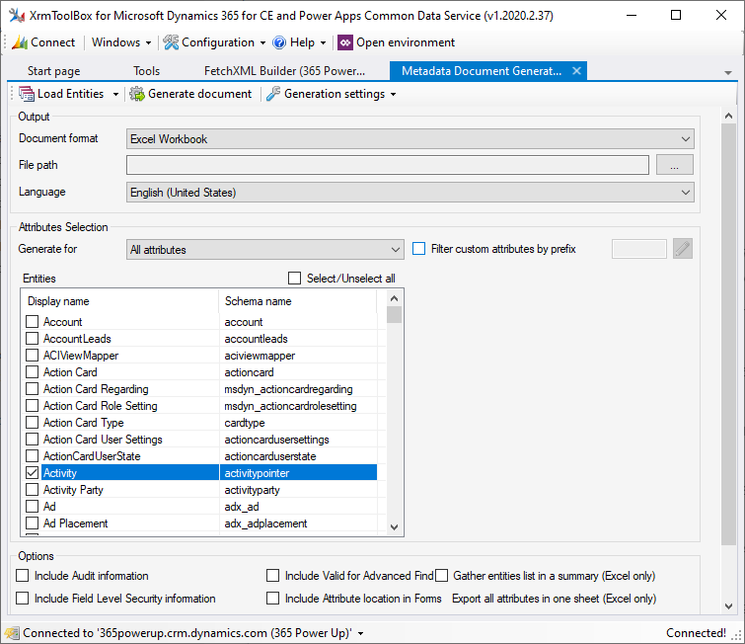
Business Analyst Tool
Metadata Document Generator
Export system schema information to Excel or Word
Filter on only selected Publishers, Entities, and/or Attributes
Additional options for extended Entity metadata
Notes:
Open source? I was able to contribute to this!

Slide 7
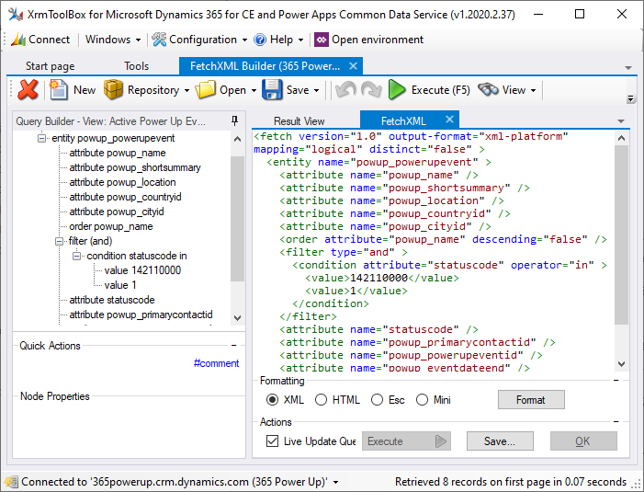
Developer Tool
FetchXml Builder
Visual tool to build and test FetchXml
View Fetch results as a grid, JSON, or raw Xml
Generate C# or JavaScript code from FetchXml
Generate snippets for Power Automate Flows

Slide 8
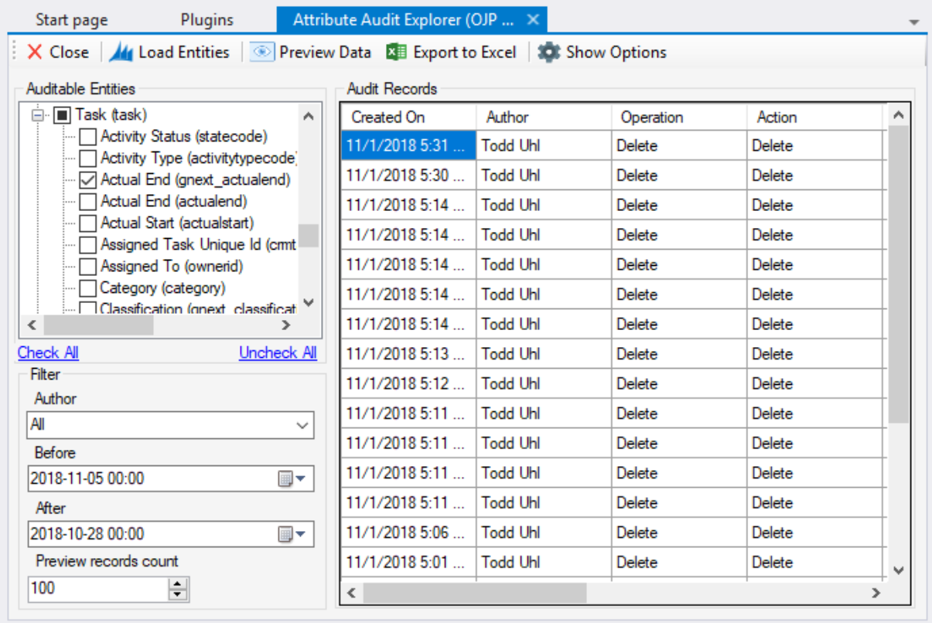
System Admin Tool
Attribute Audit Explorer
Review Entities with Audit Enabled
View logged Audit data for one or more Entity Attributes for a given
Export results to Excel for logging

Slide 9
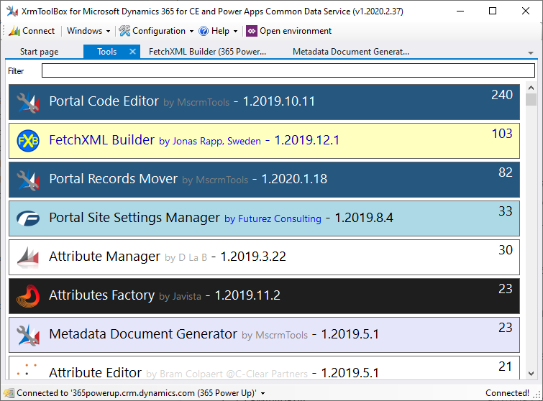
Building Your Own Tool
just how do I get started rolling out my own cool tools?!

Slide 10
What makes up an XrmToolBox Tool?
.NET component hosted by the XrmToolBox application that implements a programmatic contract
Plugin Class
.NET class extending the PluginBase class
Contains the public details behind an XrmToolBox Tool
XrmToolBox uses this to load the Tool into the application
PluginControl Class
.NET class extending PluginControlBase class
Visual / UI elements and core logic for an XrmToolBox Tool
This is the developer’s area for providing a visual interface for their Tool

Slide 11
Plugin Class
Provide the public details for your XrmToolBox tool
Tool Name
Description
Large and Small Icons
Copyright information
Allows the XrmToolBox application to instantiate and present your Tool as a registered plugin
Controls creation of your Tool user interface
You will typically derive from a base class, PluginBase

Slide 12
PluginControl Class
Service
WorkAsync
Update Connection
Settings
Logging
Notifications
PluginControl Base
This is the user interface for your Tool, where most of your work will be done
Derives from PluginControlBase Class
Existing Properties and Methods provide both utility and a standard model for building Tools
Tools that require multiple connections – derive from MultipleConnectionsPluginControlBase

Slide 13
Getting Started – Dev Tools and Templates
Visual Studio – Express or higher
XrmToolBox Plugin Project Template for Visual Studio
https://marketplace.visualstudio.com/items?itemName=TanguyTMVPCRM.XrmToolBoxPluginProjectTemplate-19499
Depending on your Tool
Third party components such as UI controls
Additional NuGet packages for tool operation or packaging and deployment

Slide 14

Demo
Enough with the slides, Let’s see some code
Notes:
New Project – Walk through template
New PluginControl
Settings – access to a shared set of settings for your Tool
Service – OrganizationService object for active connection
WorkAsync – do not lock up the user interface
Notifications – notify the user of what’s going on with your Tool
Logging – shared logging for diagnostics or error tracing
IStatusBarMessenger, IGitHubPlugin, IHelpPlugin, IPayPalPlugin
Debugging – show settings for debugging
Show cool data grid!

Slide 15
More reading!
XrmToolBox developer documentation:
https://www.xrmtoolbox.com/documentation/for-developers/
Jonas Rapp - https://jonasrapp.net/
Daryl LaBar - http://dotnetdust.blogspot.com/
FutureZ Blog - https://futurezconsulting.com/blog/
Our Demo Project - https://futz.news/xrmtbdemo
Github – Common Controls:
https://github.com/jamesnovak/xrmtb.XrmToolBox.Controls

